Slide 1
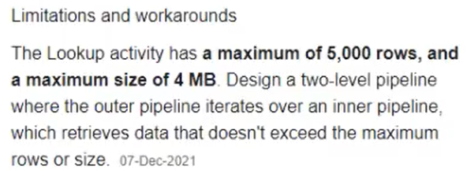
Script activity supports more than 5,000 rows

Slide 2
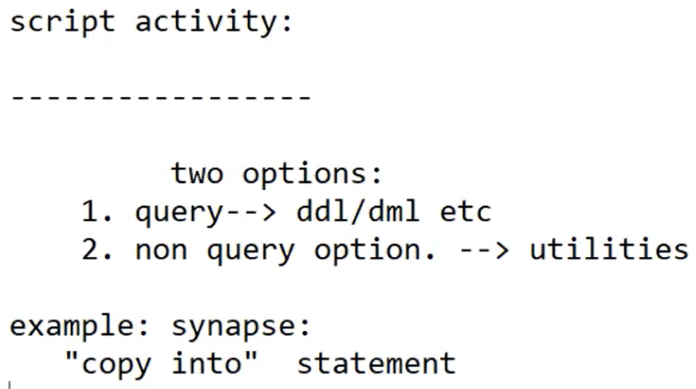
Lookup activity: in Query only SELECT statement can apply. You can’t apply other statements like insert, update & delete.
Script activity: you can give any (DML, DDL) statement.
Script activity:
1) Not recommended for big volumes. Because it is not using spark cluster.

